Slide 1
Prediction of the disulfide-bonding state of cysteines in proteins based on dipeptide composition
Jiang-Ning Song, Ming-Lei Wang, Wei-Jiang Li and Wen-Bo Xu
Biochemical and Biophysical Research Communications 318 (2004) 142–147
Presenter : Chih-Ying Lin
Date : Sept. 04, 2009

Slide 2
Abstract
In this paper, a novel approach has been introduced to predict the disulfide-bonding state of cysteines in proteins by means of a linear discriminator based on their dipeptide composition. The prediction is performed with a newly enlarged dataset with 8114 cysteine-containing segments extracted from 1856 non-homologous proteins of well-resolved three-dimensional structures. The oxidation of cysteines exhibits obvious cooperativity: almost all cysteines in disulfide-bond-containing proteins are in the oxidized form. This cooperativity can be well described by protein’s dipeptide composition, based on which the prediction accuracy of the oxidation form of cysteines scores as high as 89.1% and 85.2%, when measured on cysteine and protein basis using the rigorous jackknife procedure, respectively. The result demonstrates the applicability of this new relatively simple method and provides superior prediction performance compared with existing methods for the prediction of the oxidation states of cysteines in proteins.

Slide 3
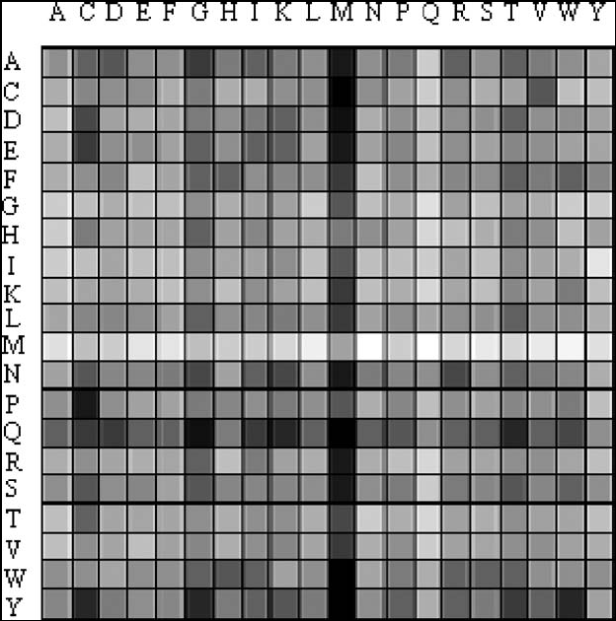
Dipeptide
Four hundred dipeptide contribution weights to disulfide bond
formation. Bar’s dark shades indicate high propensity to form disulfide
bonds of the corresponding dipeptide while light shades indicate low
propensity for disulfide bond formation.

Slide 4


Method
Ex: ADADAEP
AD:2 v_{ad} = 1
DA:2 v_{da} = 2
AE:1 v_{ae} = 3
EP:1 v_{ep} = 4
Q_{k} = 2*1+2*2+1*3+1*4 = 13

Slide 5

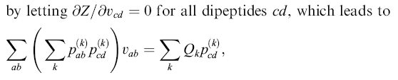
Method
where the summations on k run over all protein sequences in the dataset.
By solving the equation,the fitted parameters vab can be obtained.

Slide 6
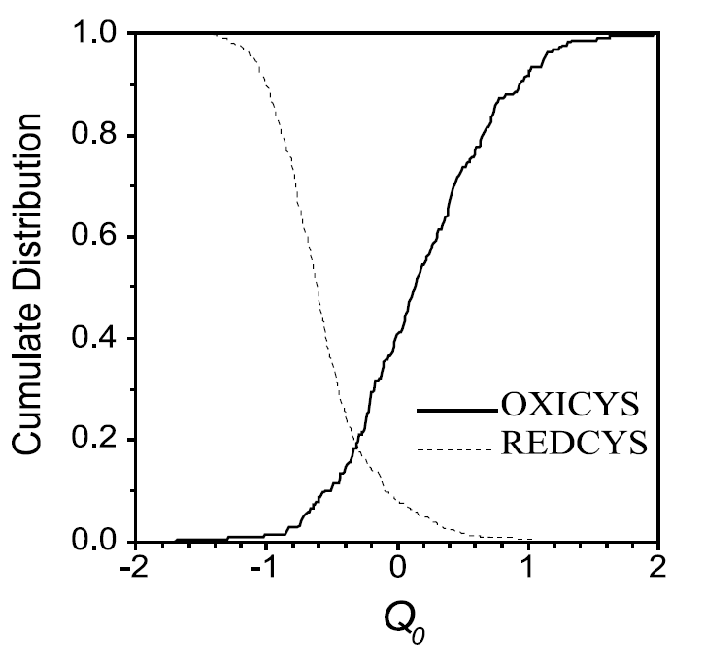
Cumulative distributions of the Q values for OXICYS and REDCYS proteins.

Slide 7
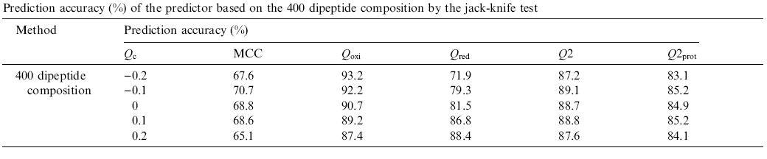
Results
The 459 OXICYS proteins have 2719 cysteines,
of which 2354 take part in intra-chain disulfide bonds.
That is to say, almost all (87%) cysteines in OXICYS proteins are oxidized.
While 5395 cysteines in 1397 REDCYS proteins are all in free form.

